Slide 1
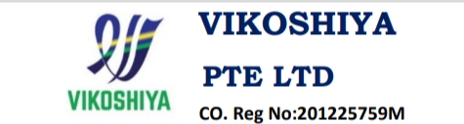
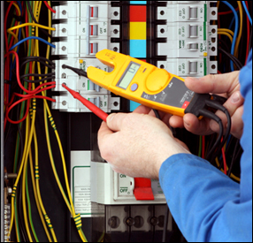
COMPANY PROFILE
We certify that, The best of our Knowledge the Information in this Profile is Accurate

Slide 2

Contact Details
SOORIYANARAYANAN.
Vikoshiya Private Ltd
3, Soon Lee Street
#05-09 Pioneer Junction
SINGAPORE – 627606
Tel: 68020616
Fax: 68023505
Mobile : 86557033
Email: viko@vikoshiya.com
Web site: www.vikoshiya.com

Slide 3

Introduction
Our objective is to provide best quality in Electrical & Instrumentation services. We are proficient in the Electrical design, field of experience to execute all type of Electrical & ELV, Security systems works and also specialist in Instrumentation & Control system side.
Vikoshiya has successfully attained bizSAFE Level Star from Workplace Safety and Health (WSH) Council which is a statutory body under the Singapore Ministry of Manpower.
Vikoshiya is certified ISO 9001 & 45001.

Slide 4
Mission & Vision
Loyalty
Building of mutually beneficial relationships both internally and externally that stand the test of circumstances and time.
Customer Satisfaction
By listening to our customers and responding to their needs we seek to add value and exceed their expectations.
Commitment
Being prepared to dedicate time and energy to fulfil obligations in the pursuit of the group’s objectives.
Excellence
The pursuit of outstanding qualities and outcomes.
Integrity
The demonstration of the above values in adherence to the code of conduct.

Slide 5
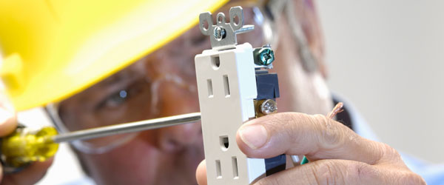
Our Key Services
HT & LT Panel and cabling works
General Lighting & Power distribution
Instrumentation and Control systems
Fire Alarm System
CCTV, ACS & Security Control system
ELV system (Public Address, Audio & Video)
BAS/BMS control system
Telephone & Data system

Slide 6

Our Valuable Clients
Google Data Center, Lok Yang Way, Singapore
Novartis Singapore Pte Ltd, Singapore
Lonza Biologies Tuas Pte Ltd, Singapore
Quantum Automation Pte Ltd, Singapore
Power Light Engineering Pte Ltd, Singapore
Techniques Eng & Air-Conditioning Pte Ltd, Singapore
Hitachi Infrastructure Systems (Asia) Pte Ltd
Influx Electrical Pte Ltd, Singapore
Light10 Engineering Pte Ltd, Singapore
Bradley Construction Pte Ltd, Singapore
Siemens Pte Ltd, Singapore
Shinryo Corporation, Singapore (MRT project)
JEL Maintenance Pte. Ltd. (JML), Singapore
(Sanofi EVF facility, Tuas)

Slide 7
Track Records
Projects and Maintenance works Track records
S/N | Project Name | Maincon | Job Description | Duration
 |  |  |  | From | To
1 | Lonza Biologics Tuas Pte. Ltd. | Vikoshiya Pte. Ltd. | Instrumentation, Data & Tel, Security System Supply and Installation, Maintenance works | Nov-12 | Till date
2 | Kulicke & Soffa Pte. Ltd | Influx Engineering Services Pte. Ltd. | Electrical and Instrumentation, Data & Tel, Security System, CCTV Supply and Installation works | Dec-12 | Oct-13
3 | Singapore Sports Hub | Light 10 Industries Pte. Ltd. | Electrical and Instrumentation, Data & Tel, Security System, CCTV Supply and Installation works | Nov-13 | Apr-14
4 | Novartis BioPharm Ops (Phase-1) | Powerlite Engineering Pte. Ltd. | Supply and Installation of Electrical and Instrumentation, BMS and Data & Tel works including clean room | Apr-14 | Oct-15
5 | Nagase FineChem Singapore Pte. Ltd.(Extension Project) | Hitachi Infrastructure System Asia Pte. Ltd. | Supply and Installation of Electrical and Instrumentation, BMS and Data & Tel works | Aug-14 | Jun-15
6 | AbbVie Operations Singapore Pte. Ltd | Kurihara Kogyo Co. Ltd. | Supply and Installation of Electrical and Instrumentation works including clean room | Sep-15 | Aug-16
7 | Novartis BioPharm Ops (Phase-2) | Powerlite Engineering Pte. Ltd. | Electrical and Instrumentation, BMS, ELV, FA, PA, ACS, CCTV, Data & Tel, Gas Detection System, Leak Detection System works including clean room | Apr-16 | Mar-17
8 | Amgen ASM3 | Techniques Air-Conditioning & Engineering Pte. Ltd. | Electrical and Instrumentation, BMS work Supply and Installation works including clean room | Sep-16 | Dec-17
9 | LYW-1A Google Data Center | Powerlite Engineering Pte. Ltd. | Electrical Supply and Installation works | Mar-19 | Aug-20
10 | Techniques Module Facility | Vikoshiya Pte. Ltd. | Electrical and Instrumentation, ACS, CCTV, PA, Data & Tel equipment's installation works | Nov-19 | Jul-20
11 | Techniques Module Facility | Vikoshiya Pte. Ltd. | Maintenance and additional works | Aug-20 | Till date
12 | Amgen ASM3 | Vikoshiya Pte. Ltd. | Electrical and Instrumentation, BMS, Security system Maintenance and Additional works | Mar-18 | Till date
13 | Arkema Symphony Project (Jurong Island) | Rotary Engineering Pte. Ltd. | Electrical and Instrumentation, Air Tubing Installation works | Mar-22 | Sep-22
14 | Silicon Box | Mahalakshmi Electricals | Supply and Installation of Electrical works including clean room | Jul-22 | May-23
15 | Siltronic Silicon Wafer Pte. Ltd. | Plant Electrical Instrumentation Pte. Ltd. | Supply and Installation of Instrumentation works including clean room | Feb-23 | Dec-23
16 | Sanofi EVF facility | JEL Maintenance Pte. Ltd | Supply and Installation of Data & Tel, ACS and CCTV works | Apr-23 | Till date
14 | C850E CCL6 & NEL ML and Depot Extension | Gates PCM Construction Ltd. | MRT Track and Maintenance works | Sep-23 | Till date

Slide 8
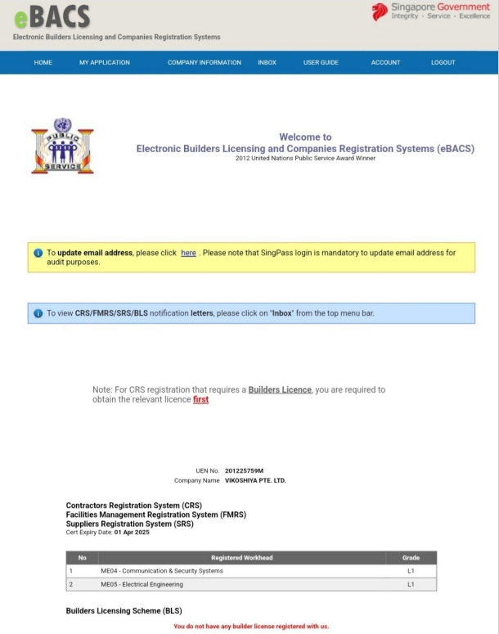
Accreditation
BCA cert

Slide 9
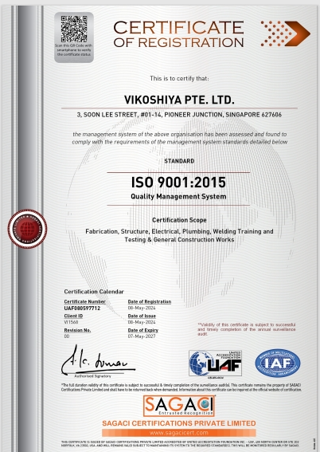
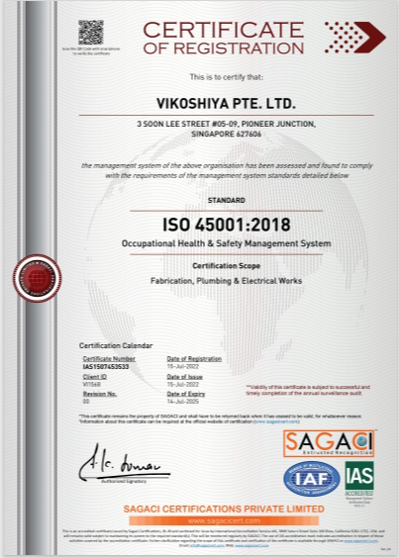
Accreditation :
ISO certs

Slide 10
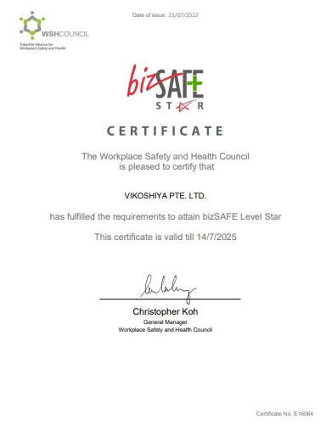
Accreditation
bizSAFE STAR

Slide 11
HSE Statistics
Description | 2020 | 2021 | 2022 | 2023
No. of Safety Warnings / Notices from any government agencies | 0 | 0 | 0 | 0
No. of regulatory Reportable Incidents | 0 | 0 | 0 | 0
No. Lost Time Accidents | 0 | 0 | 0 | 0
Accident Frequency Rate (AFR) / Million Hrs (No. of Work place Reported/No. of Man-hours Worked)*1,000,000) | 0 | 0 | 0 | 0
Accident Severity Rate (ASR) / Million Hrs (No. of Man Days Lost to Workplace Accidents/No. of Man-hours Worked)*1,000,000 | 0 | 0 | 0 | 0
Workplace Injury Rate (No. of Fatal and Non-Fatal Workplace Injuries/No. of Employed Persons)*100,000) | 0 | 0 | 0 | 0
No. of Occupational Disease Incidences | 0 | 0 | 0 | 0
Cumulative Total of Recordable Incident Rate (TRIR) (No of recordable incidents project/No of man-hours worked project to date)*1,000,000) | 0 | 0 | 0 | 0
No. of fatalities that the company incurred | 0 | 0 | 0 | 0
Manhours worked for the year | 54,317 | 172,813 | 198,450 | 252,542
Manhours lost for the year | 0 | 0 | 0 | 0

Slide 12
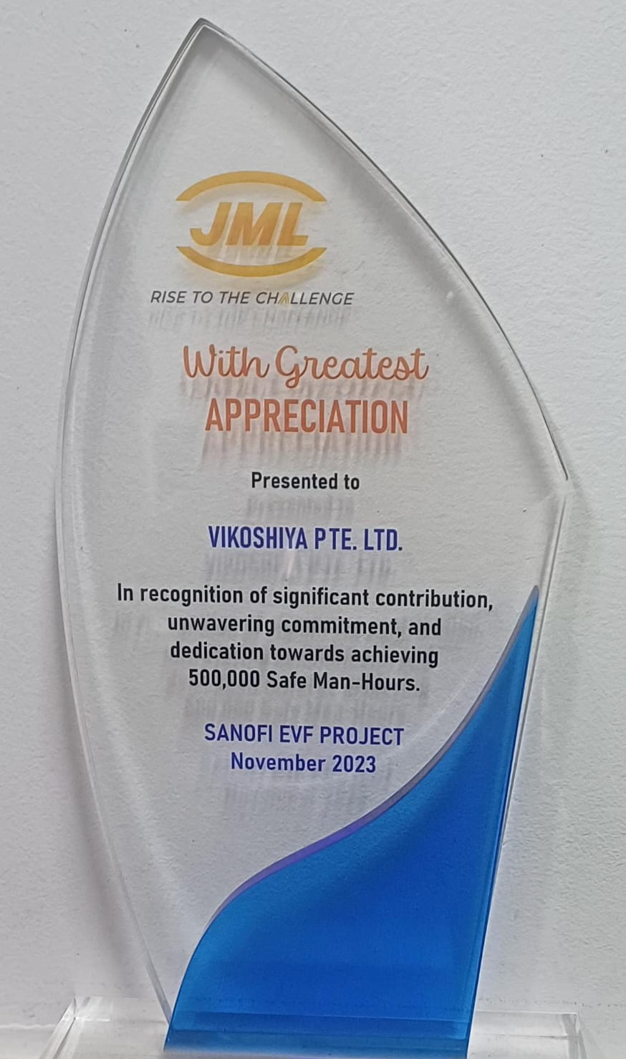
Awards &
Appreciations

Slide 13



